Slide 1




ACES Tutorial for using Graphcore Intelligence Processing Units (IPUs) for AI/ML workflows
07/24/2023
Zhenhua He, Richard Lawrence, Wesley Brashear, Dhruva Chakravorty, Lisa Perez, Honggao Liu

Slide 2
IPU Tutorial
Section I. Intro to IPUs
We will introduce Graphcore IPU architecture, and the IPU systems on TAMU ACES platform.
04
Section IV. Porting PyTorch code to IPU
We will learn to port a PyTorch Fashion-MNIST classification model to run on IPU
01
Q&A
(10 mins/sec)
03
Section II. Demo on ACES
We will demonstrate how to run models of different frameworks on ACES IPU system.
Section III Porting TensorFlow code to IPU
We will learn to port a Keras MNIST classification model to run on IPU
02
Structure of the IPU Tutorial.

Slide 3


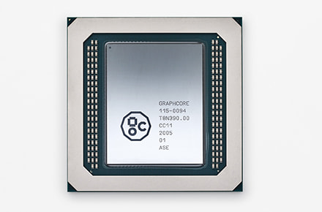
Section I. ACES and IPU Systems Overview

Slide 4
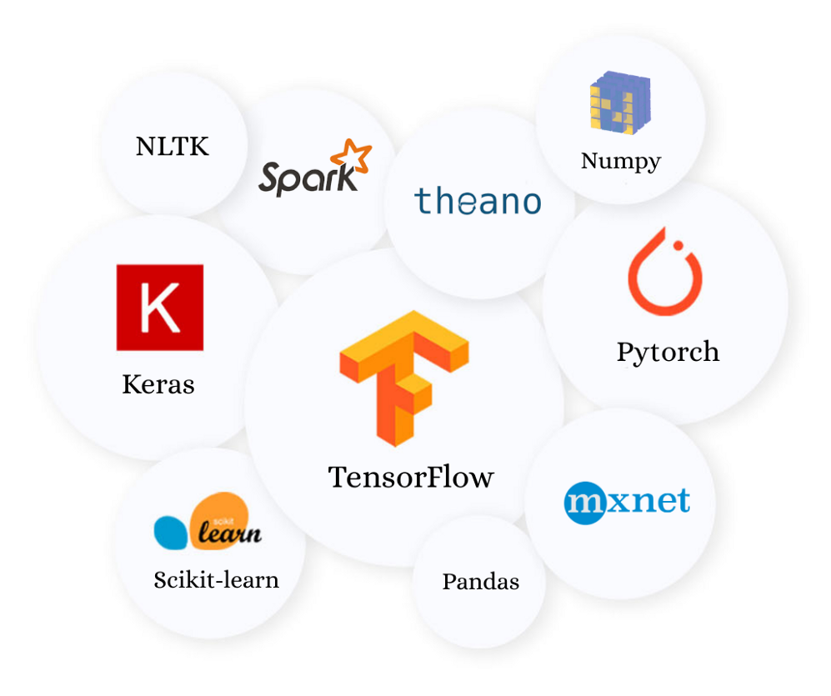
ACES
Accelerating Computing for Emerging Sciences
Mission:
Offer an accelerator testbed for numerical simulations and AI/ML
Provide consulting, technical guidance, and training to researchers
Collaborate on computational and data-enabled research.
Credit: towardsdatascience.com

Slide 5
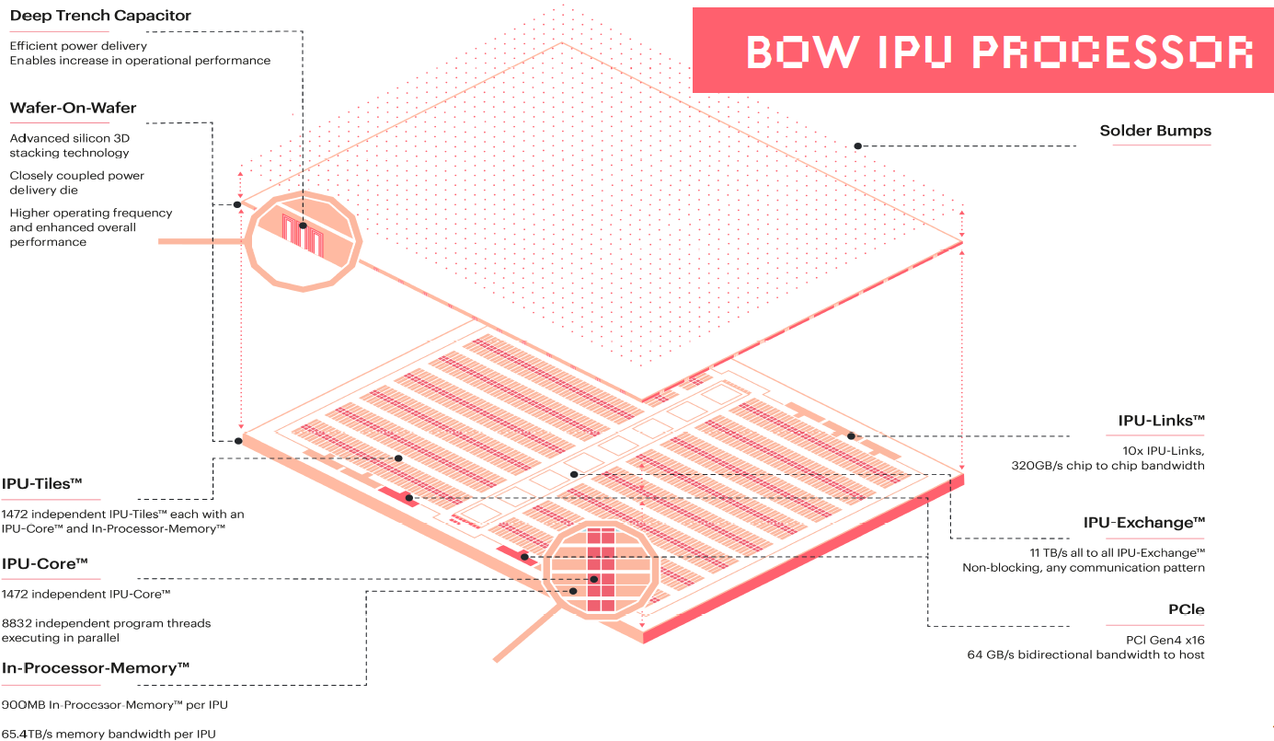
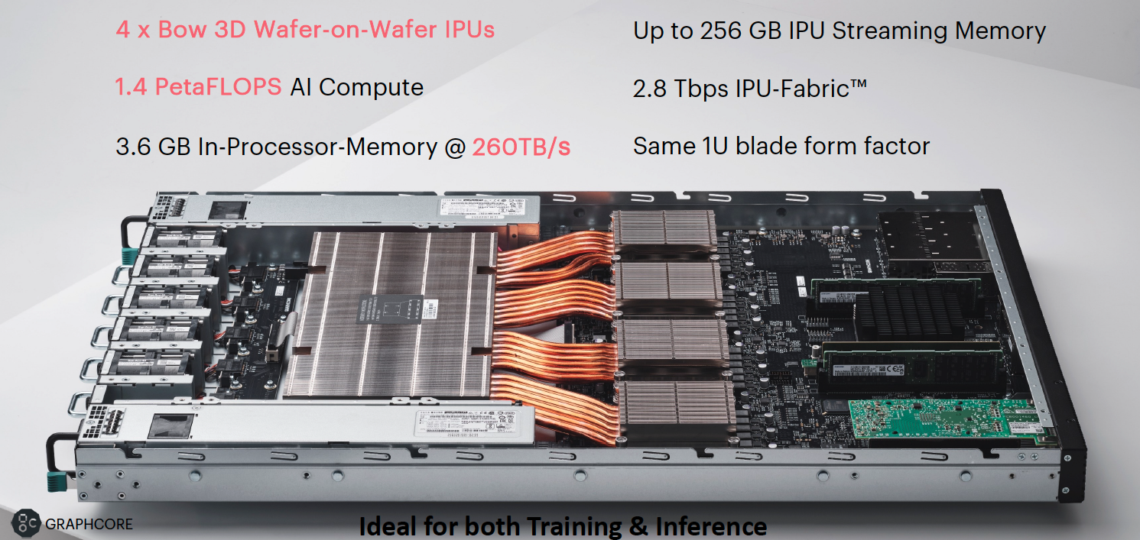
Source: Graphcore

Slide 6
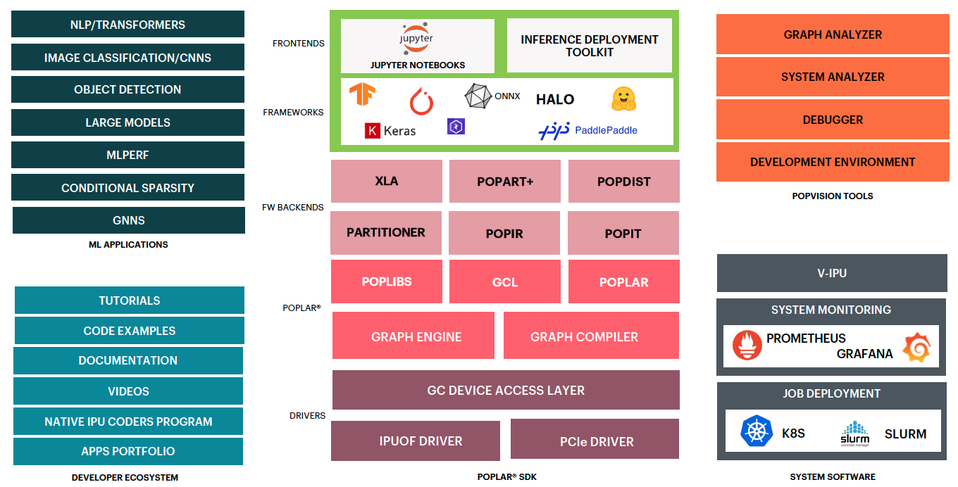
Graphcore Software Stack
Source: Graphcore

Slide 7


















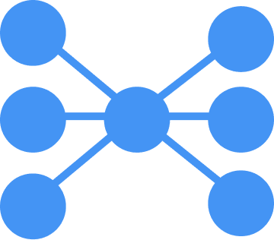



MODEL GARDEN COVERAGE
COMPUTER VISION
GNN
IMAGE CLASSIFICATION
OBJECT
DETECTION
TGN
NEW
Cluster-GCN
NEW
MPNN-GIN
NEW
SchNet
NEW
ResNet50 v1.5
YOLO v3
GPS++
NEW
NBFNet
NEW
EfficientNet-B0
YOLO v4
Distr. KGE
NEW
EfficientNet-B4
Faster RCNN
ResNeXt-101
AI FOR SIMULATION
MobileNet v2
EfficientDet
DeepMD
CosmoFlow
MobileNet v3
DeepDriveMD
ABC Covid-19
ViT
OBJECT SEGMENTATION
ET0
DINO
Unet (Industrial)
REINFORCEMENT
PROBABILISTIC
NEW
SWIN
MAE
Unet (Medical)
RL
MCMC
Reinforcement Learning
VAE
NLP
SPEECH
BERT-Base
RoBERTa
BERT-Large
Deberta
STT (ASR)
TTS
Group | Packing
BART
RNN-T
DeepVoice3
GPT2
T5
FastSpeech2
Hubert
Conformer
FastPitch
NEW
GPT-J
DistilBERT
NEW
RECOMMENDER
MULTIMODAL
OTHER
POPART
Autoencoder
LXMERT
Mini DALL-E
Sales Forecast
DIN
CLIP
Frozen In Time
NEW
Neural Image Fields
DIEN
Stable Diffusion
NEW

Slide 8
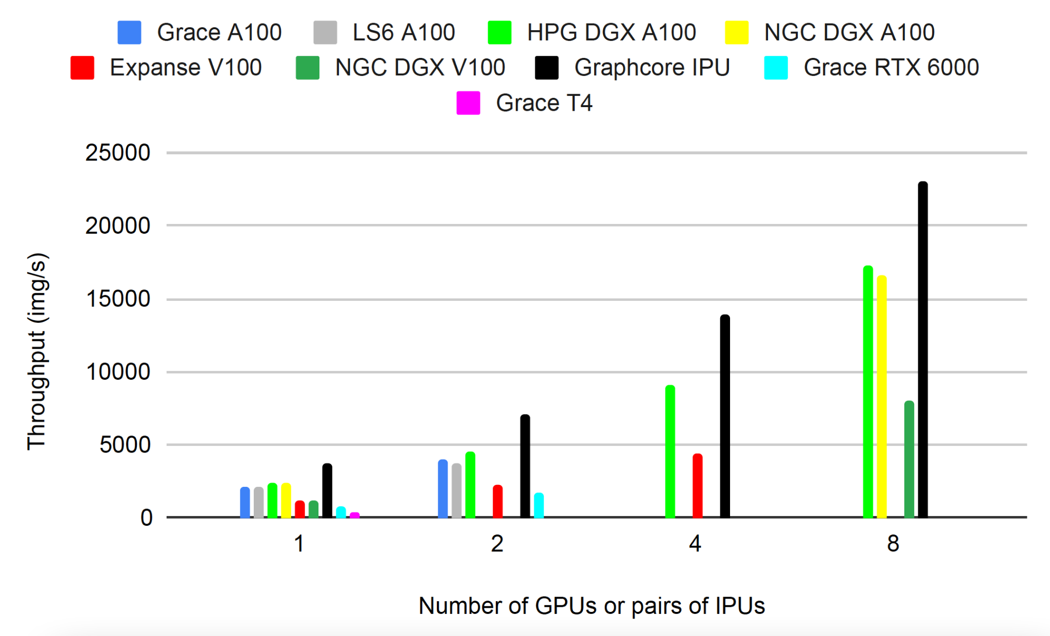
PyTorch ResNet50 - GPU vs IPU
Abhinand S. Nasari, Hieu T. Le, Richard Lawrence, Zhenhua He, Xin Yang, Mario M. Krell, Alex Tsyplikhin, Mahidhar Tatineni, Tim Cockerill, Lisa M. Perez, Dhruva K. Chakravorty and Honggao Liu. 2022. Benchmarking the Performance of Accelerators on National Cyberinfrastructure Resources for Artificial Intelligence / Machine Learning Workloads. In Practice and Experience in Advanced Research Computing (PEARC '22), July 10-14, 2022, Boston, MA, USA. ACM, New York, NY, USA, 13 Pages. https://doi.org/10.1145/3491418.3530772
Notes:
Link to NSF page

Slide 9
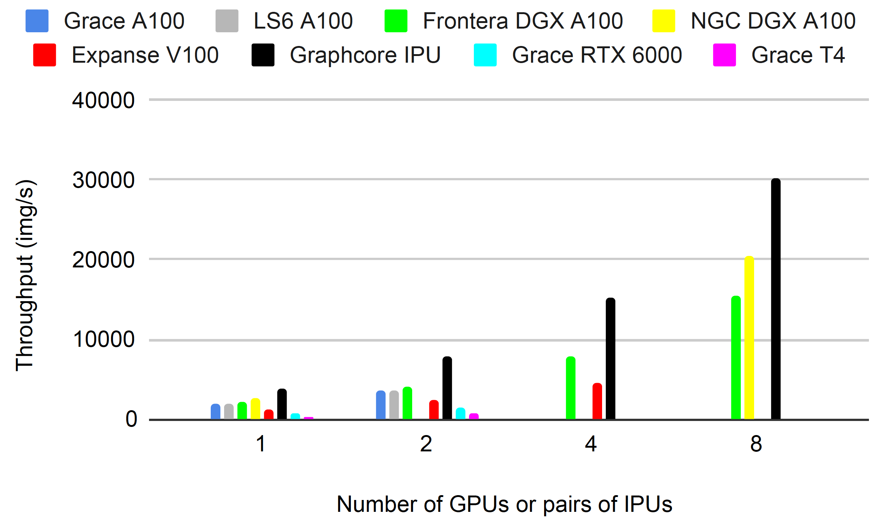
TensorFlow ResNet50 - GPU vs IPU
Abhinand S. Nasari, Hieu T. Le, Richard Lawrence, Zhenhua He, Xin Yang, Mario M. Krell, Alex Tsyplikhin, Mahidhar Tatineni, Tim Cockerill, Lisa M. Perez, Dhruva K. Chakravorty and Honggao Liu. 2022. Benchmarking the Performance of Accelerators on National Cyberinfrastructure Resources for Artificial Intelligence / Machine Learning Workloads. In Practice and Experience in Advanced Research Computing (PEARC '22), July 10-14, 2022, Boston, MA, USA. ACM, New York, NY, USA, 13 Pages. https://doi.org/10.1145/3491418.3530772
Notes:
Link to NSF page

Slide 10

Section II. Demo on ACES

Slide 11

Log into ACES Using the HPRC Portal
HPRC webpage: https://hprc.tamu.edu/, Portal dropdown menu

Slide 12
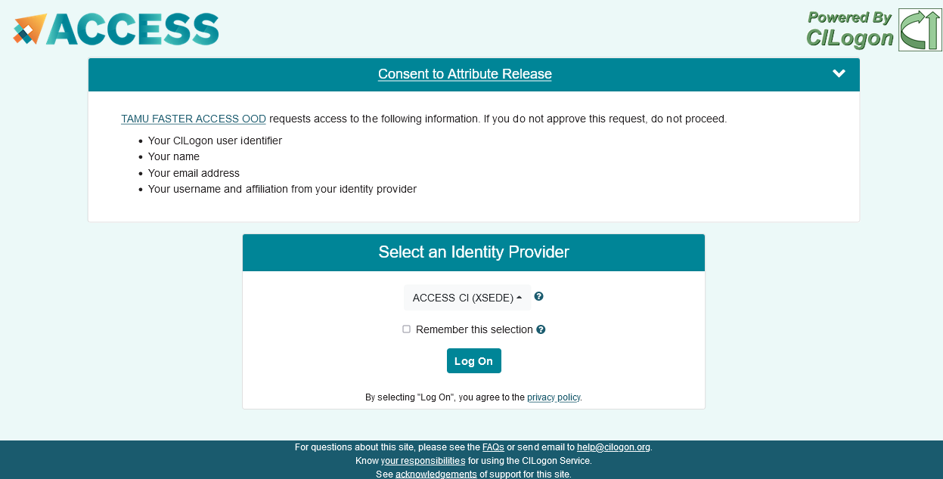

Accessing ACES via the ACES Portal (ACCESS)
Log-in using your ACCESS credentials.
Select the Identity Provider appropriate for your account.

Slide 13

Shell access via the HPRC Portal
Access through (most) web browsers
–Top Banner Menu “Clusters” -> “Shell Access”

Slide 14
Training Materials
From the ACES login node, ssh into the poplar2 (BOW Pod16) IPU system
Change to your scratch directory:
Copy the example materials to your scratch directory:
Copy the hands-on exercise materials to your scratch directory:
ssh poplar2
cd $SCRATCH
git clone https://github.com/graphcore/examples.git
git clone https://github.com/happidence1/IPU-Training.git

Slide 15
Poplar SDK setup
source /opt/gc/poplar/poplar_sdk-ubuntu_20_04-3.3.0+1403-208993bbb7/poplar-ubuntu_20_04-3.3.0+7857-b67b751185/enable.sh
source /opt/gc/poplar/poplar_sdk-ubuntu_20_04-3.3.0+1403-208993bbb7/popart-ubuntu_20_04-3.3.0+7857-b67b751185/enable.sh
mkdir -p $SCRATCH/tmp
export TF_POPLAR_FLAGS=--executable_cache_path=$SCRATCH/tmp
export POPTORCH_CACHE_DIR=$SCRATCH/tmp

Slide 16
Run a TensorFlow (TF) model on IPU

Slide 17
TF Virtual Environment Setup
virtualenv -p python3 venv_tf2
source venv_tf2/bin/activate
python -m pip install -U pip
python -m pip install /opt/gc/poplar/poplar_sdk-ubuntu_20_04-3.3.0+1403-208993bbb7/tensorflow-2.6.3+gc3.3.0+251582+08d96978c7f+intel_skylake512-cp38-cp38-linux_x86_64.whl

Slide 18
Run a TensorFlow model on IPU
cd examples/tutorials/tutorials/tensorflow2/keras/completed_demos/
python completed_demo_ipu.py
Deactivate the virtual environment after the model finishes running.
deactivate

Slide 19
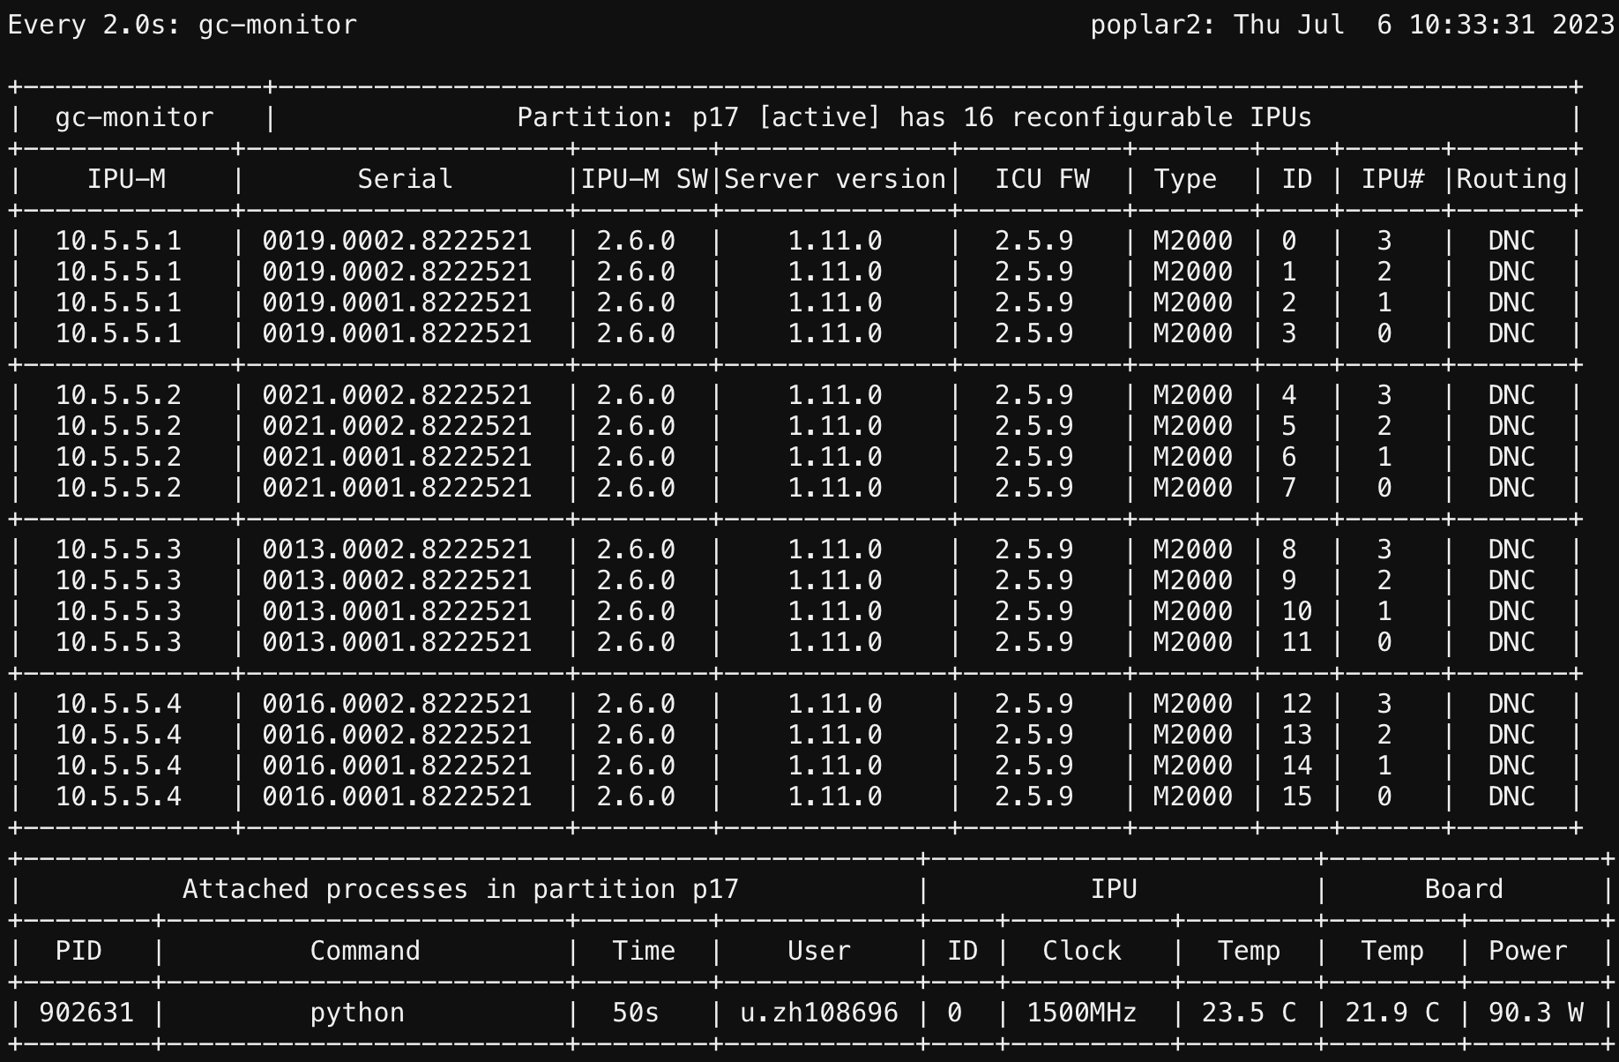
Monitor the IPU usage with gc-monitor command
watch -n 2 gc-monitor

Slide 20
Run a PyTorch (PopTorch) model on IPU

Slide 21
PopTorch Virtual Environment Setup
cd $SCRATCH
virtualenv -p python3 poptorch_test
source poptorch_test/bin/activate
python -m pip install -U pip
python -m pip install /opt/gc/poplar/poplar_sdk-ubuntu_20_04-3.3.0+1403-208993bbb7/poptorch-3.3.0+113432_960e9c294b_ubuntu_20_04-cp38-cp38-linux_x86_64.whl

Slide 22
Run a PopTorch model on IPU
cd $SCRATCH/examples/tutorials/simple_applications/pytorch/mnist/
pip install -r requirements.txt
python mnist_poptorch.py
Deactivate the virtual environment after the model finishes running.
deactivate

Slide 23

Monitor the IPU usage with gc-monitor command
watch -n 2 gc-monitor

Slide 24
Hands-On Session 1
Please access ACES and poplar2 now.
Copy the tutorial materials to your scratch directory.
Run the TensorFlow and PyTorch (PopTorch) example models on IPU

Slide 25


Section III. Porting TensorFlow Code to IPU

Slide 26
1. Import the TensorFlow IPU module
Add the following import statement to the beginning of your script:
from tensorflow.python import ipu

Slide 27
2. Preparing the dataset
Make sure the sizes of the datasets are divisible by the batch size
def make_divisible(number, divisor):
return number - number % divisor
Adjust dataset lengths
(x_train, y_train), (x_test, y_test) = load_data()
train_data_len = x_train.shape[0]
train_data_len = make_divisible(train_data_len, batch_size)
x_train, y_train = x_train[:train_data_len], y_train[:train_data_len]
test_data_len = x_test.shape[0]
test_data_len = make_divisible(test_data_len, batch_size)
x_test, y_test = x_test[:test_data_len], y_test[:test_data_len]

Slide 28
3. Add IPU configuration
To use the IPU, you must create an IPU session configuration:
ipu_config = ipu.config.IPUConfig()
ipu_config.auto_select_ipus = 1
ipu_config.configure_ipu_system()
A full list of configuration options is available in the API documentation.

Slide 29
4. Specify IPU strategy
strategy = ipu.ipu_strategy.IPUStrategy()
The tf.distribute.Strategy is an API to distribute training and inference across multiple devices. IPUStrategy is a subclass which targets a system with one or more IPUs attached.

Slide 30
5. Wrap the model within the IPU strategy scope
Creating variables and Keras models within the scope of the IPUStrategy object will ensure that they are placed on the IPU.
To do this, we create a strategy.scope()context manager and move all the model code inside it.

Slide 31
Hands-on Session 2
Activate the TF virtual environment
cd $SCRATCH
source venv_tf2/bin/activate
Change directory to Keras
cd IPU-Training/Keras
Complete the #Todos in the mnist-ipu-todo.py file.
Run it in the venv_tf2 virtual environment.
python mnist-ipu-todo.py
After finishing the job, you can deactivate the virtual environment
deactivate

Slide 32

Section IV. Porting PyTorch Code to IPU

Slide 33
PopTorch
PopTorch is a set of extensions for PyTorch released by Graphcore to enable PyTorch models to run on Graphcore's IPU hardware.
PopTorch will use PopART to parallelise the model over the given number of IPUs. Additional parallelism can be expressed via a replication factor, which enables you to data-parallelise the model over more IPUs.

Slide 34
Training a model on IPU
Import the packages
import torch
import poptorch
import torchvision
import torch.nn as nn
import matplotlib.pyplot as plt
from tqdm import tqdm
from sklearn.metrics import accuracy_score

Slide 35
Load the data
PopTorch offers an extension of torch.utils.data.DataLoader class with its poptorch.DataLoader class, specialized for the way the underlying PopART framework handles batching of data.

Slide 36
Build the model
class ClassificationModel(nn.Module):
def __init__(self):
super().__init__()
self.conv1 = nn.Conv2d(1, 5, 3)
self.pool = nn.MaxPool2d(2, 2)
self.conv2 = nn.Conv2d(5, 12, 5)
self.norm = nn.GroupNorm(3, 12)
self.fc1 = nn.Linear(972, 100)
self.relu = nn.ReLU()
self.fc2 = nn.Linear(100, 10)
self.log_softmax = nn.LogSoftmax(dim=1)
self.loss = nn.NLLLoss()
def forward(self, x, labels=None):
x = self.pool(self.relu(self.conv1(x)))
x = self.norm(self.relu(self.conv2(x)))
x = torch.flatten(x, start_dim=1)
x = self.relu(self.fc1(x))
x = self.log_softmax(self.fc2(x))
# The model is responsible for the calculation of the loss when using an IPU. We do it this way:
if self.training:
return x, self.loss(x, labels)
return x
model = ClassificationModel()
model.train()

Slide 37
Prepare training for IPUs
The compilation and execution on the IPU can be controlled using poptorch.Options. These options are used by PopTorch's wrappers such as poptorch.DataLoader and poptorch.trainingModel.
opts = poptorch.Options()
train_dataloader = poptorch.DataLoader(
opts, train_dataset, batch_size=16, shuffle=True, num_workers=20
)

Slide 38
Train the model
optimizer = poptorch.optim.SGD(model.parameters(), lr=0.001, momentum=0.9)
poptorch_model = poptorch.trainingModel(model, options=opts, optimizer=optimizer)
epochs = 30
for epoch in tqdm(range(epochs), desc="epochs"):
total_loss = 0.0
for data, labels in tqdm(train_dataloader, desc="batches", leave=False):
output, loss = poptorch_model(data, labels)
total_loss += loss
poptorch_model.detachFromDevice()
torch.save(model.state_dict(), "classifier.pth")

Slide 39
Evaluate the model
model = model.eval()
poptorch_model_inf = poptorch.inferenceModel(model, options=opts)
test_dataloader = poptorch.DataLoader(opts, test_dataset, batch_size=32, num_workers=10)
predictions, labels = [], []
for data, label in test_dataloader:
predictions += poptorch_model_inf(data).data.max(dim=1).indices
labels += label
poptorch_model_inf.detachFromDevice()
print(f"Eval accuracy: {100 * accuracy_score(labels, predictions):.2f}%")

Slide 40
Hands-on Session 3
Activate the TF virtual environment
cd $SCRATCH
source poptorch_test/bin/activate
Change directory to PyTorch
cd IPU-Training/PyTorch
Complete the #Todos in the fashion-mnist-pytorch-ipu-todo.py file.
Run it in the poptorch_test virtual environment.
pip install scikit-learn
python fashion-mnist-pytorch-ipu-todo.py
After finishing the job, you can deactivate the virtual environment
deactivate

Slide 41
References
https://www.graphcore.ai/
https://github.com/graphcore/examples/tree/v3.2.0/tutorials/tutorials/tensorflow2/keras
https://github.com/graphcore/examples/tree/v3.2.0/tutorials/tutorials/pytorch/basics
https://hprc.tamu.edu/wiki/Main_Page

Slide 42

https://hprc.tamu.edu
HPRC Helpdesk:
help@hprc.tamu.edu
Phone: 979-845-0219
Help us help you. Please include details in your request for support, such as, Cluster (ACES, Faster, Grace, Terra, ViDaL), Job information (Job id(s), Location of your jobfile, input/output files, Application, Module(s) loaded, Error messages, etc), and Steps you have taken, so we can reproduce the problem.
Notes:
update

